Slide 1
UNITED WAY IMPACT REPORT
THIS IMAGE IS A DEFAULT. PLEASE CUSTOMIZE WITH A COMPANY-SPECIFIC ONE.
[INSERT COMPANY NAME HERE]
INSERT COMPANY LOGO HERE

Slide 2
THANK YOU!
ONWARD860
United Way of Central and Northeastern Connecticut has a bold vision for the future – Onward860 – which is built on insights and feedback from our community; a century of service, a belief in a better future for our region; and, equity at our core.
Our approach involves:
Aligning community, corporate, government and philanthropic partners to end poverty
Leveraging 100 years of expertise, experience, data, community voice and resources to deepen impact
Connecting people with resources and opportunities to make a difference
Transforming the future with game-changing solutions and partnerships
FOR BEING OUR PARTNER

Slide 3
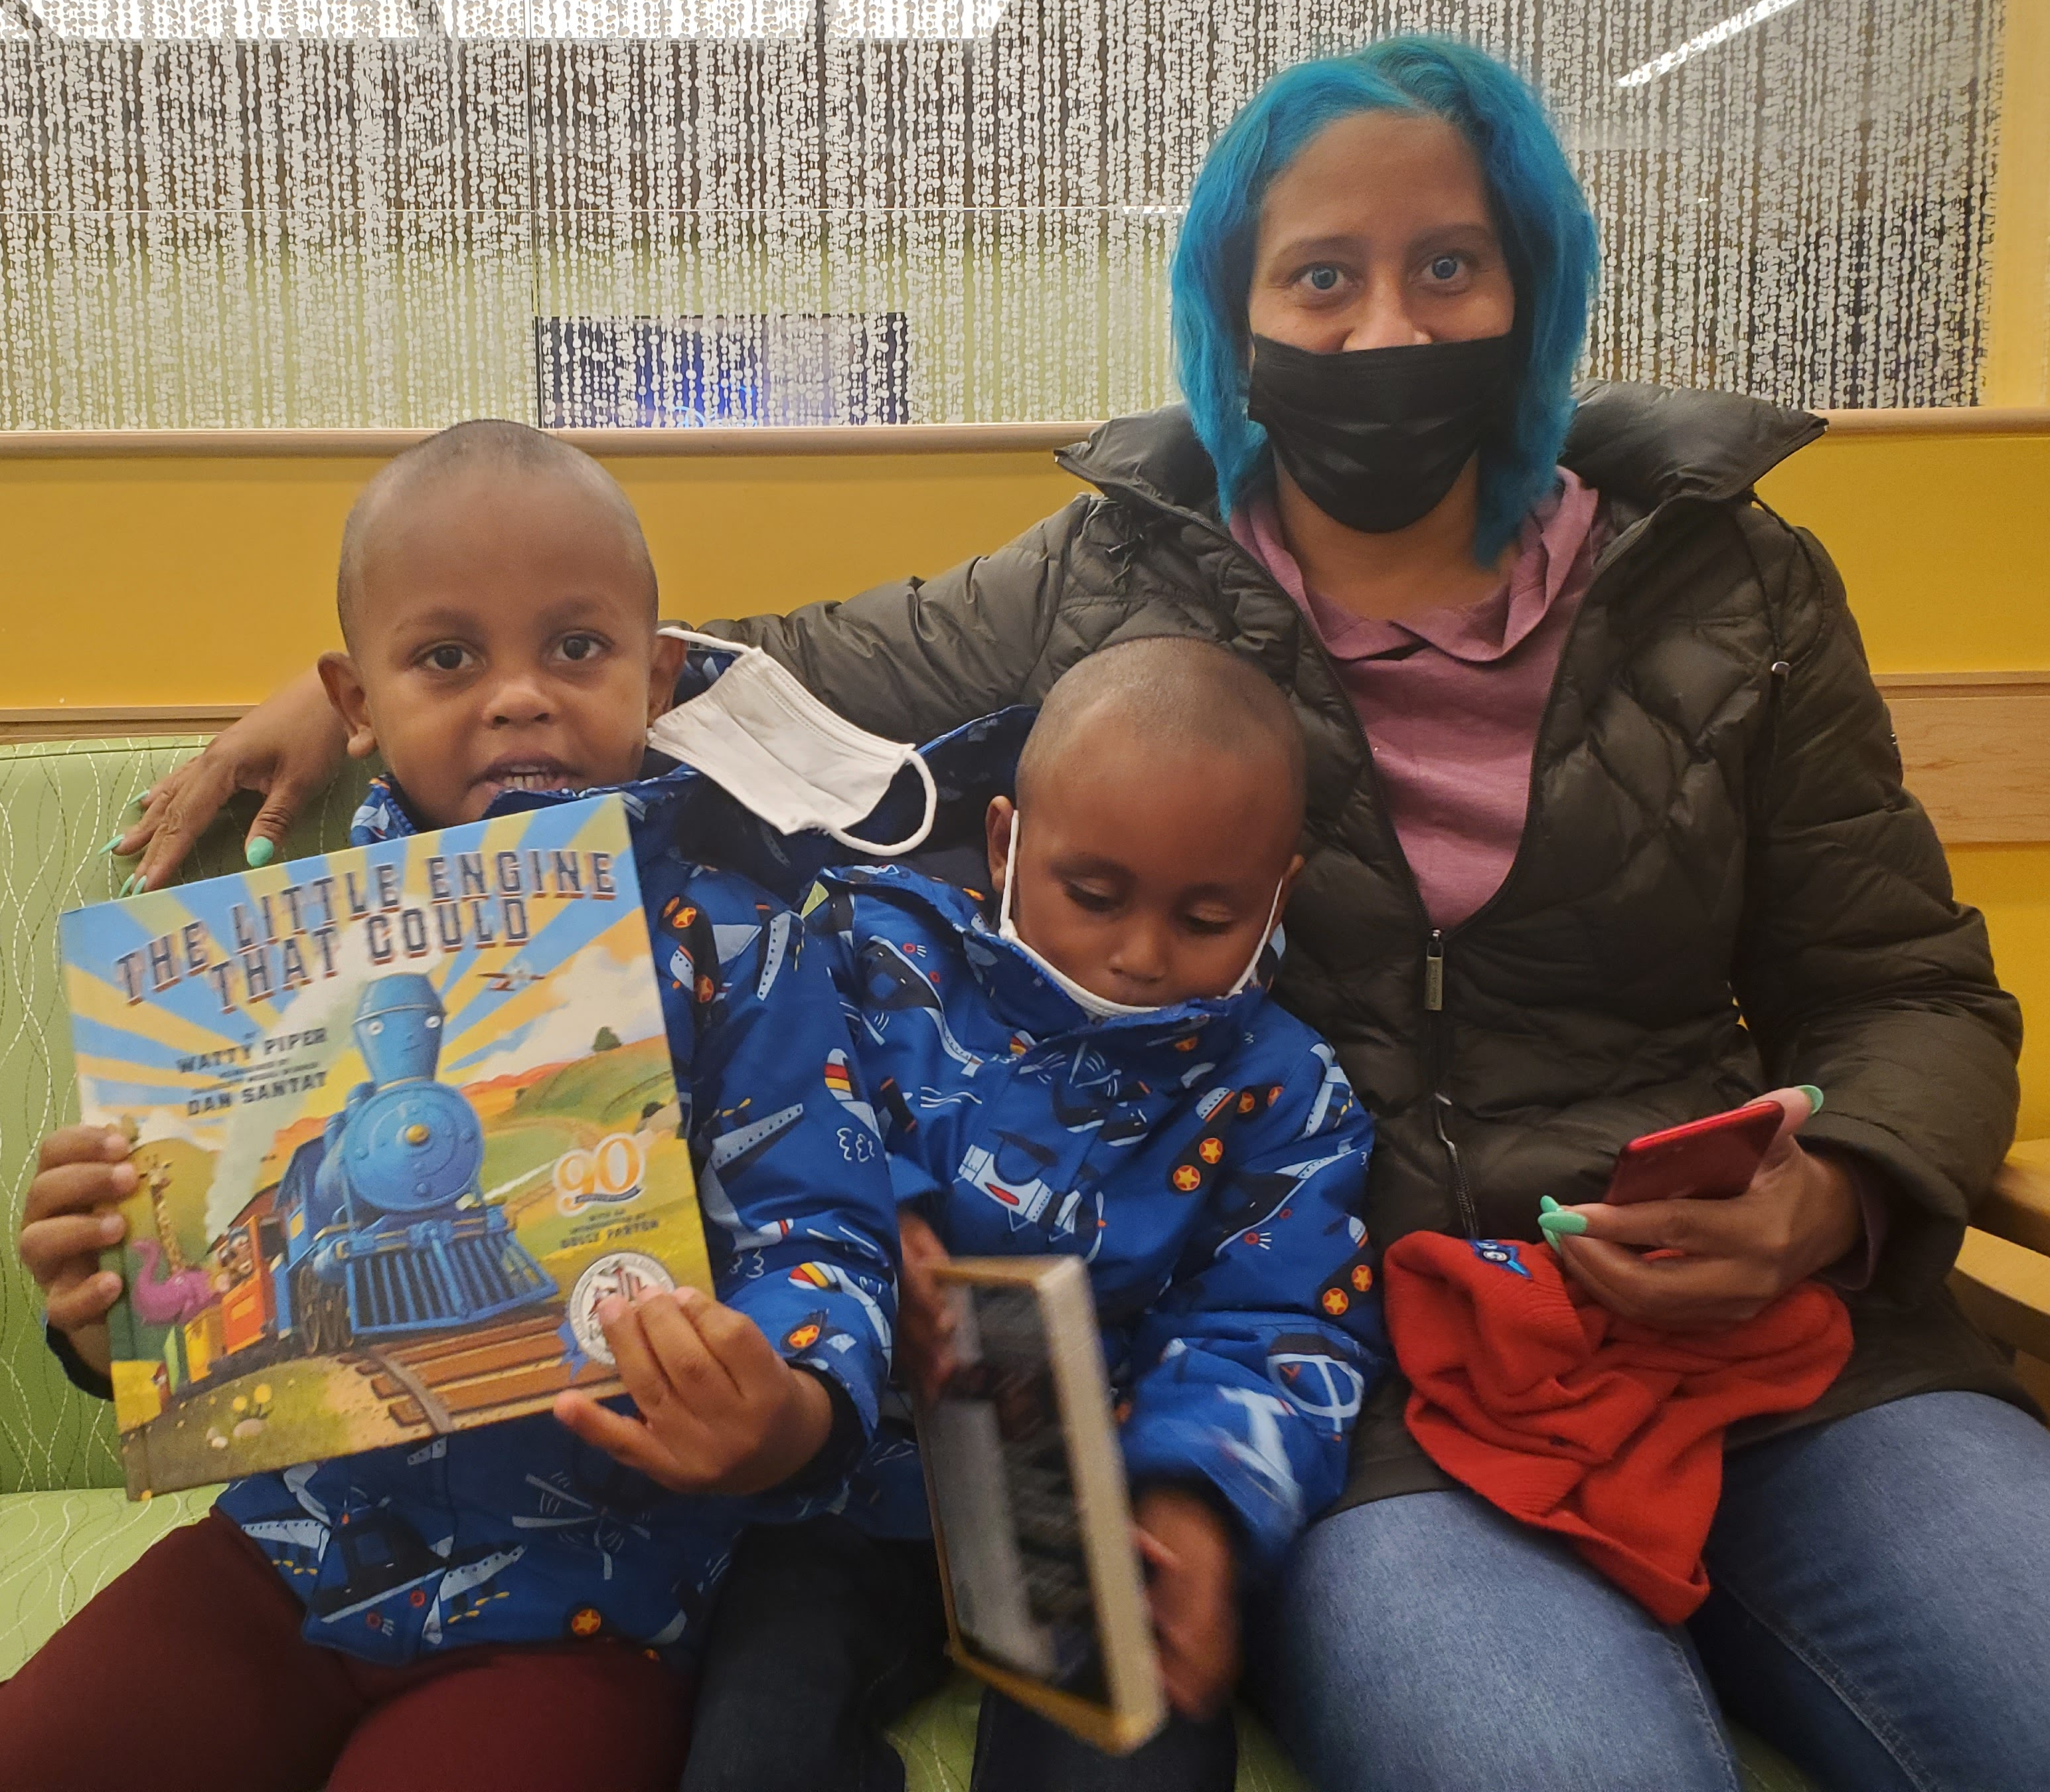
STORY OF IMPACT
Customize success story based on cause the company cares about most
For 100 years, United Way of Central and Northeastern Connecticut has closed literacy gaps and created opportunities for children to succeed in school and beyond.
Dolly Parton’s Imagination Library
Dolly Parton’s Imagination Library, a United Way-operated initiative, is a no-cost subscription program that provides one book per month to local children ages birth to five. Jennifer registered her two sons, Gabriel (2) and Michael (4), who get excited each time they see their names on the mailing labels and are quick to point out their favorite parts of the stories.
“I carry Imagination Library books with me …. since they are guaranteed to hold [my sons’] attention. I have noticed their interest in books increased since they began receiving books from the Imagination Library program,” reported Jennifer.

Slide 4
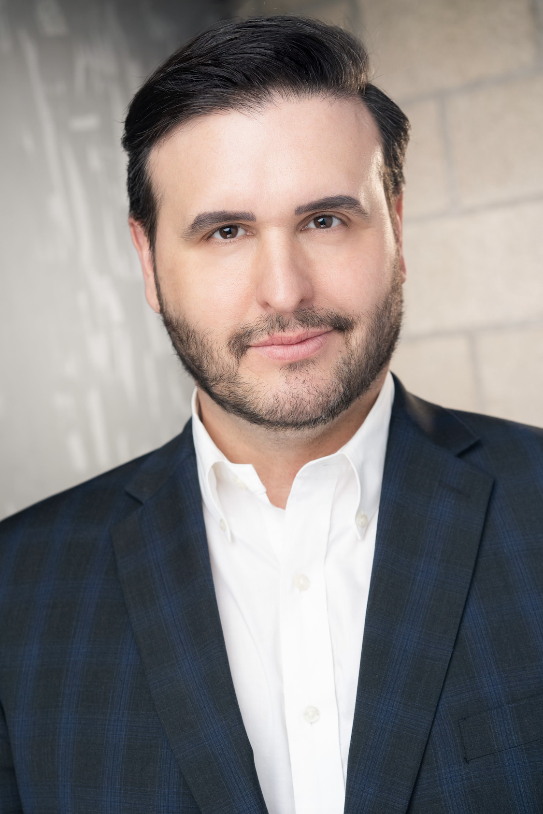
A MESSAGE FROM UNITED WAY’S PRESIDENT AND CEO
Thank you for your partnership in achieving United Way’s vision to close gaps and create opportunities to make the 860 region an equitable place where everyone succeeds.
Our centennial marks a critical milestone in our organization’s history, and denotes a time when the community needs United Way more than ever. We have a tremendous responsibility to create brighter futures for local children, adults and families. As we embrace a century of service to the 860 region, we also have a responsibility to inspire our donors and volunteers to take action.
As I look ahead, I’m eager to engage stakeholders like you to solve relevant issues. This is vital to United Way’s evolution. Together, we will tailor impact to the most pressing needs of the community.
My hope is to inspire transformational giving to innovative programs that are game-changing for struggling households. I am here to serve, and I am honored to be leading this United Way at such a monumental time.
I am excited for the work that we will do together.
Sincerely, Eric Harrison

Slide 5
[COMPANY NAME] IMPACT REPORT
[COMPANY NAME] and United Way share a commitment to closing gaps in child literacy, housing, wages and life expectancy to end poverty in all its forms. [COMPANY NAME]’s values of XXXXX, XXXXX and XXXXX carry through in employee and company giving and volunteerism.
VOLUNTEERS: [NUMBER] mobilized, [NUMBER] hours
TOTAL INVESTMENT: $XXXXX [Corporate Gift / Company Match / Grants / Employee Giving]
LEADERSHIP DONORS: [NUMBER] United Way Constitution Society [NUMBER] United Way Tocqueville Society [NUMBER] United Way Women of Tocqueville
AFFINITY GROUP MEMBERS: [NUMBER] United Way Emerging Leaders Society [NUMBER] United Way Women United
UNITED WAY BOARD OF DIRECTORS: [INSERT NAME]
SPONSORSHIPS: $XXXXX [EVENT(S) SUPPORTED]
INSERT COMPANY LOGO HERE
INSERT COMPANY PICTURE HERE

Slide 6
SAVE THE DATES
Read for the Record
October 24, 2024 | Various In-Person Locations
FOX61 and United Way ImpaCT Awards October 25, 2024 | Hartford Marriott Downtown
United Way Centennial Gala December 14, 2024 | Connecticut Convention Center
Visit unitedwayinc.org/events to stay up to date!

Slide 7
THANK YOU!
THIS IMAGE IS A DEFAULT. PLEASE CUSTOMIZE WITH A COMPANY-SPECIFIC ONE.
YOUR UNITED WAY LIASION CONTACT INFORMATION:
[FULL NAME], [TITLE] EMAIL@UNITEDWAYINC.ORG | 860.493.XXXX

