Slide 1





UNITED WAY
IMPACT REPORT
[COMPANY NAME]

Slide 2




United Way of Central and Northeastern Connecticut has a bold vision for the future – Onward860 – which is built on insights and feedback from our community; more than a century of service, a belief in a better future for our region; and, equity at our core. ​
​Our approach involves:​
Aligning community, corporate, government and philanthropic partners to end poverty​
Leveraging 100+ years of expertise, experience, data, community voice and resources to deepen impact​
Connecting people with resources and opportunities to make a difference​
Transforming the future with game-changing solutions and partnerships​
12

Slide 3
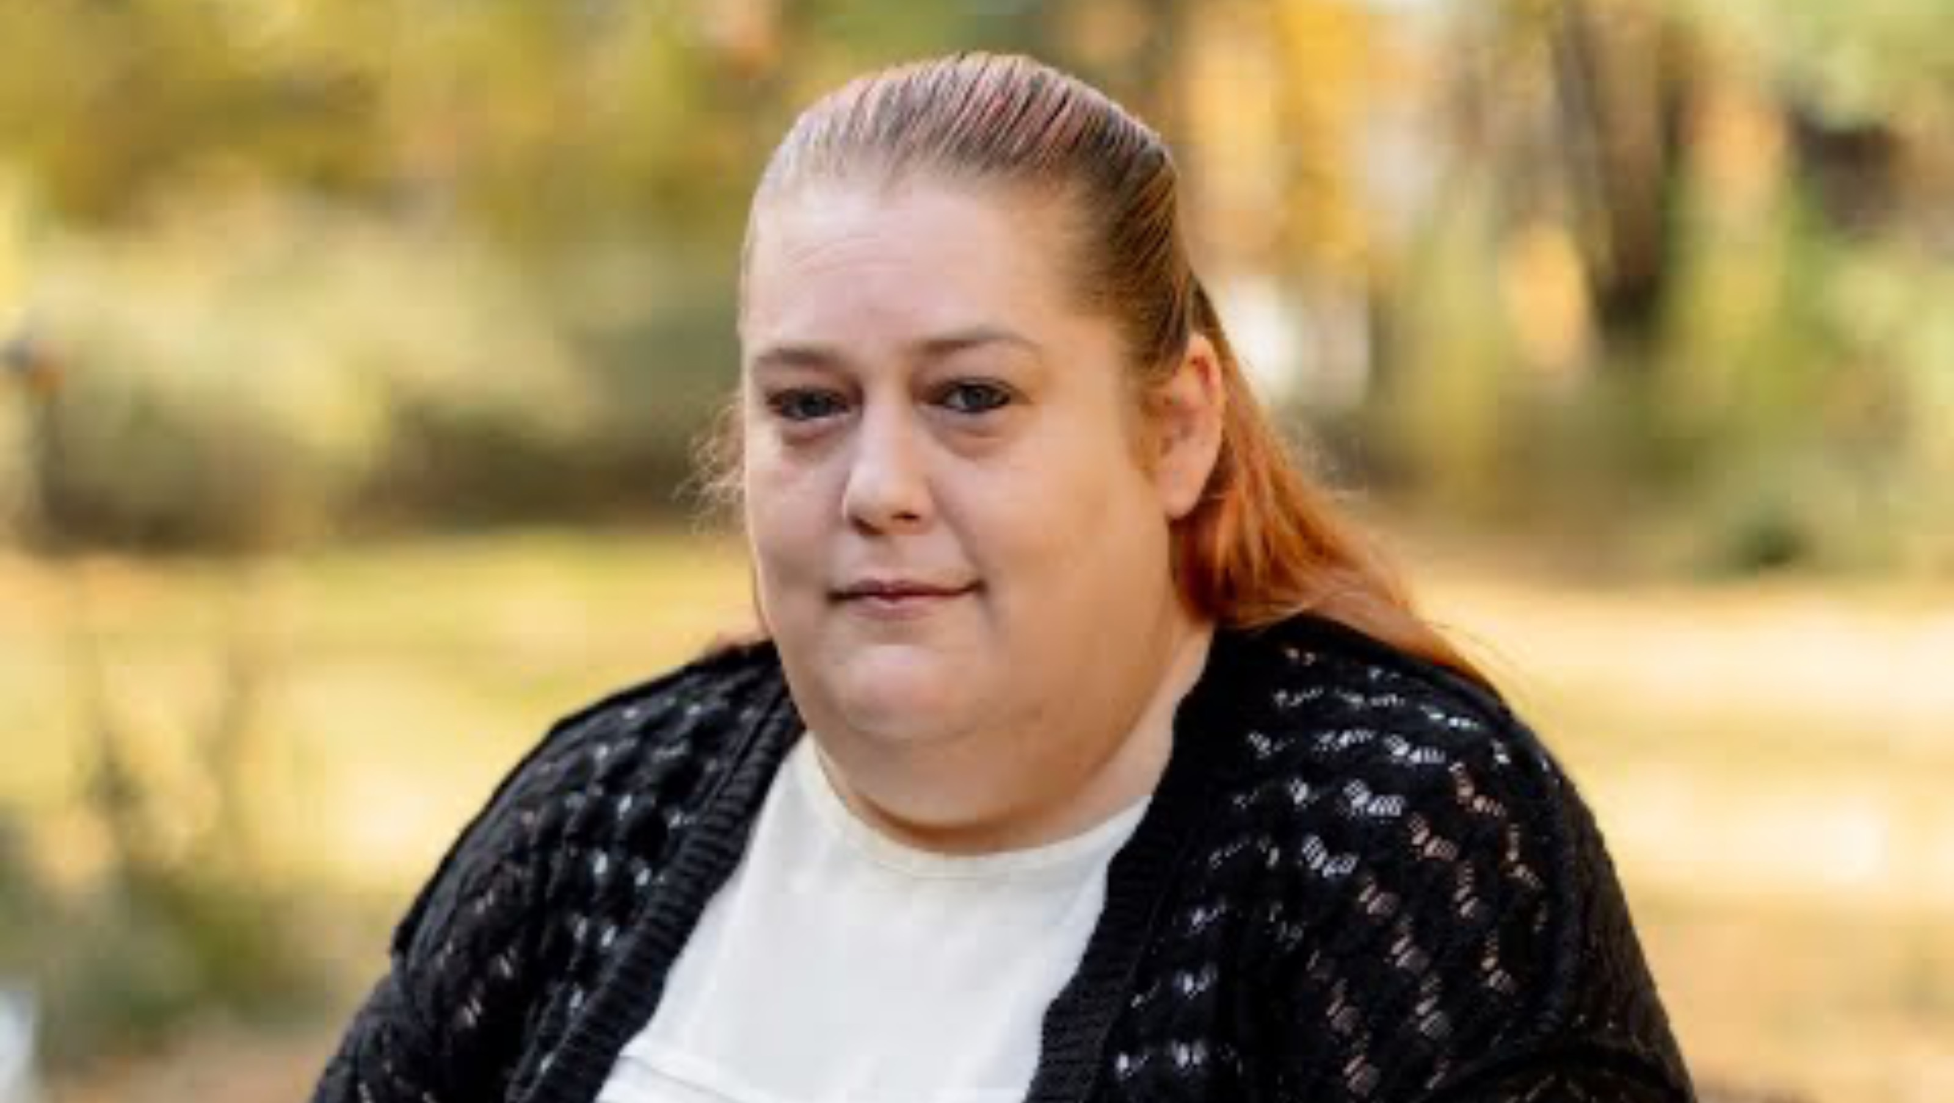
[next slides are impact stories – select one that aligns with the company’s mission and delete the rest – and this text]
STORY OF IMPACT
MEET CASSANDRA
“United Way was there for me.”
Cassandra’s family lost their home in a fire, and United Way’s Rapid Response Fund helped keep them stable as they recovered.

Slide 4
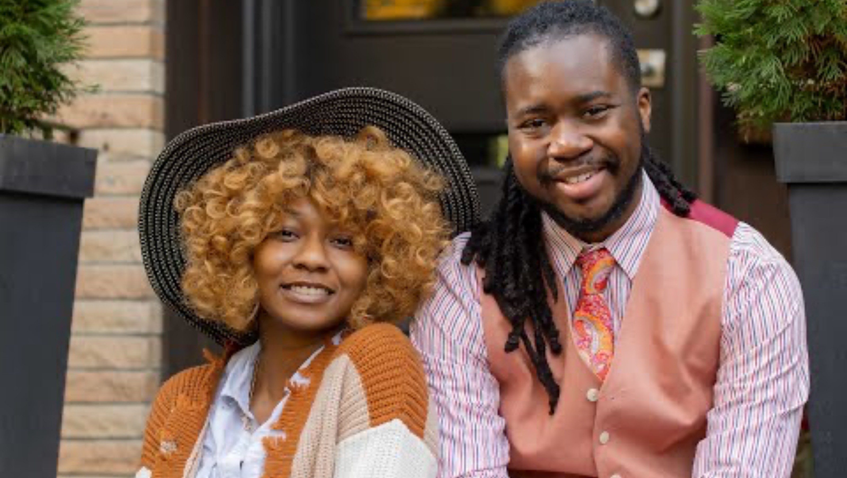
STORY OF IMPACT
MEET OUR YOUNG LEGENDS
“You can’t be for us without us.”
Hartford’s Young Legends reduce barriers for young adults seeking quality employment with family sustaining wages.

Slide 5
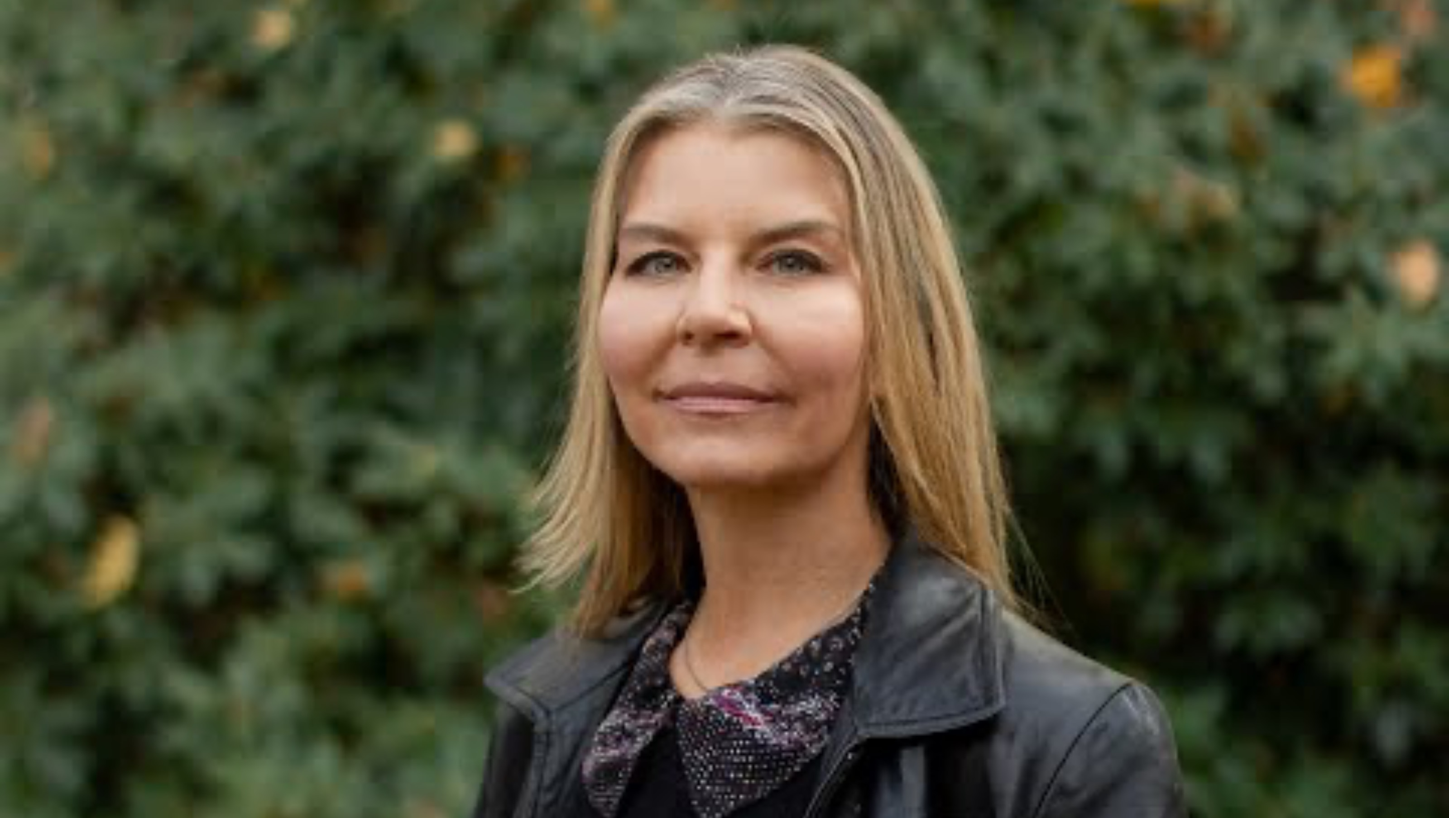
STORY OF IMPACT
MEET IRENE
“Whatever it’s going to take, let’s make it happen.”
From growing up in working poverty, to becoming a philanthropic leader, Irene is passionate about advocating for local children, adults and families.

Slide 6
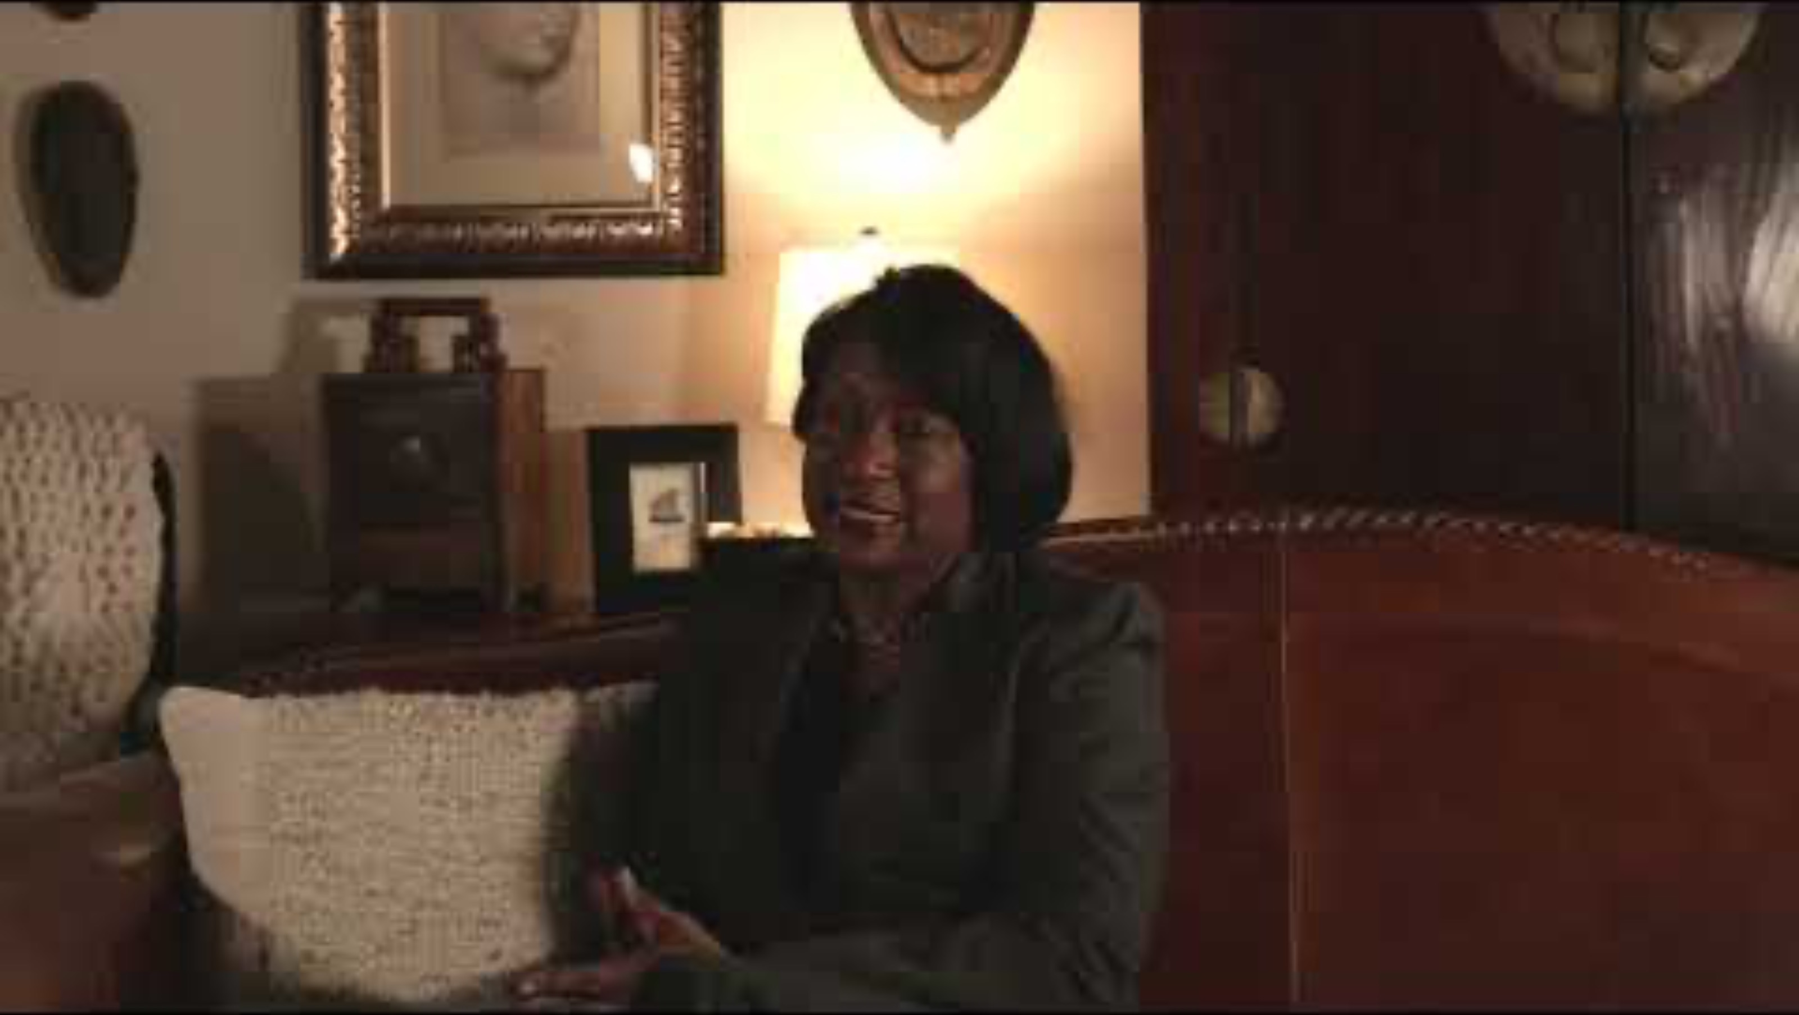
STORY OF IMPACT
MEET KAREN
“Life doesn’t stand still, so we can’t.”
Community partners for more than 100 years, our organizations work together to help lift families out of poverty.

Slide 7
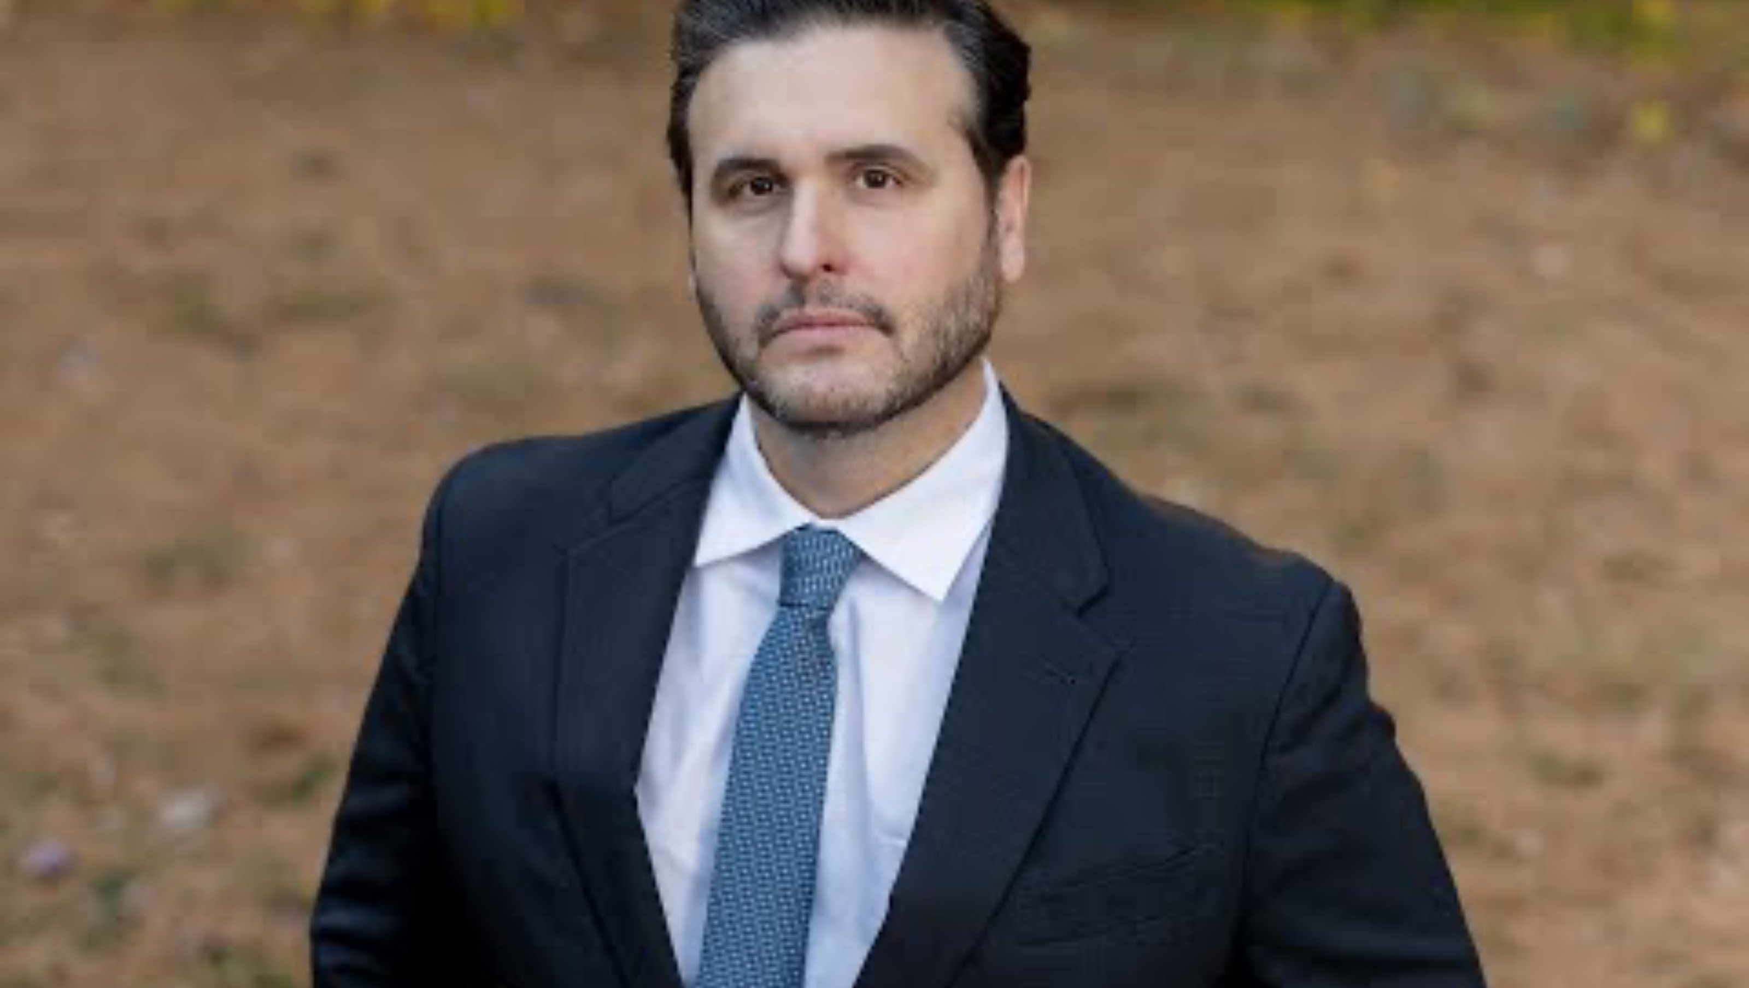
A MESSAGE FROM UNITED WAY’S PRESIDENT AND CEO
“Together, we are United to End Poverty.”
Leading our organization through transformational change, Eric Harrison shares the bold Onward860 vision for our community.

Slide 8

[COMPANY NAME’S] IMPACT REPORT
[COMPANY NAME] and United Way share a commitment to closing gaps in child literacy, housing, wages and life expectancy to help end poverty. [COMPANY NAME]’s values of XXXXX, XXXXX and XXXXX carry through in employee and company philanthropy.
VOLUNTEERS:​
[NUMBER] mobilized, [NUMBER] hours​
TOTAL INVESTMENT: ​
$XXXXX [Corporate Gift / Company Match / Grants / Employee Giving]​
LEADERSHIP DONORS:​
[NUMBER] United Way Constitution Society​
[NUMBER] United Way Tocqueville Society ​
[NUMBER] United Way Women of Tocqueville​
AFFINITY GROUP MEMBERS: ​
[NUMBER] United Way Emerging Leaders Society​
[NUMBER] United Way Women United​
UNITED WAY BOARD OF DIRECTORS:​
[INSERT NAME]​
SPONSORSHIPS:​
$XXXXX [EVENT(S) SUPPORTED]

Slide 9




SAVE THE DATES
Fox61 and United Way Impact Awards
Read Across America Day
October 22, 2025
March 6, 2026
Power of the Purse
Building Foundations
June 11, 2026
April 30, 2026
Visit unitedwayinc.org/events to learn more!

Slide 10

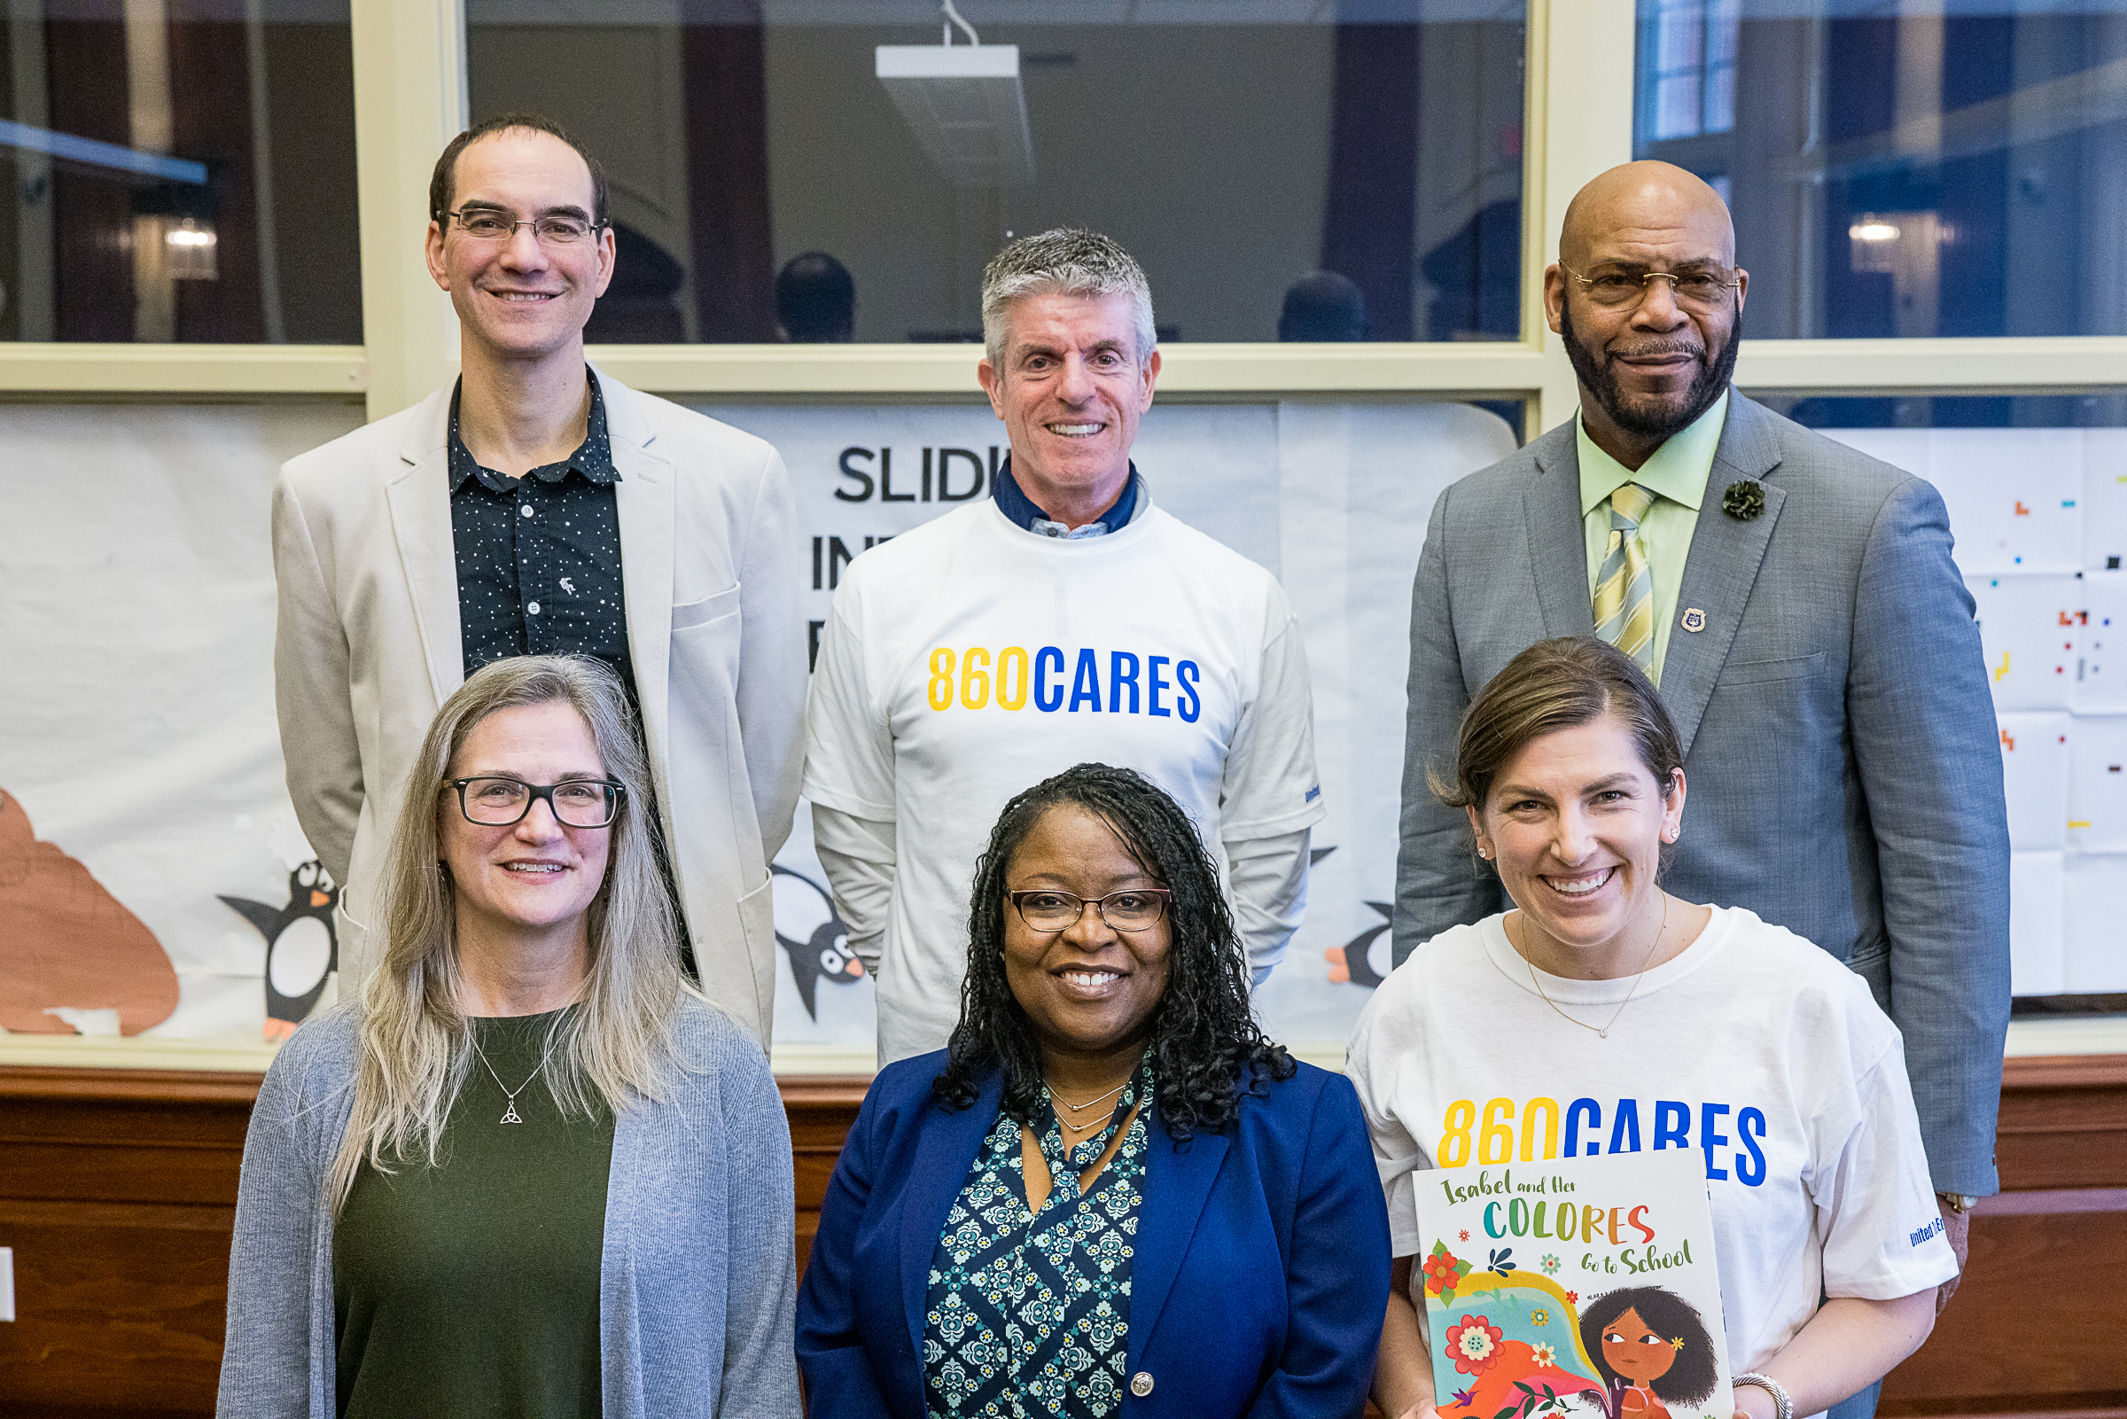
[DEFAULT IMAGE – CUSTOMIZE WITH A COMPANY SPECIFIC ONE]
THANK YOU!
[YOUR FULL NAME]
[TITLE]
EMAIL@unitedwayinc.org
860.493.[xxxx]
TOGETHER, WE ARE UNITED TO END POVERTY

Slide 11


